Slide 1
vCommunity and what’s in it for you!

Slide 2
VMware Community
The VMware Community stands for:
Fostering collaboration, innovation, and knowledge sharing among professionals, enthusiasts, partners, customers, and developers who are engaged with VMware's technologies and solutions.
Platform for individuals to connect, learn, and contribute to the advancement of VMware products, best practices, and the broader IT ecosystem.
Encompasses various channels and forums, including online communities, user groups, forums, social media platforms, events, and training programs, where members can exchange ideas, seek assistance, share expertise, and stay updated on the latest developments in virtualization, cloud computing, networking, and related areas.
The VMware community plays a crucial role in empowering its members to maximize the value of VMware solutions, drive innovation, solve challenges, and advance their careers in the rapidly evolving field of technology.
vCommunity and what’s in it for you!

Slide 3
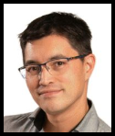
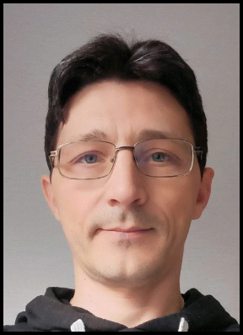
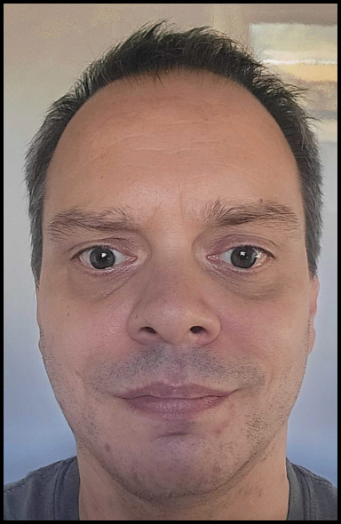
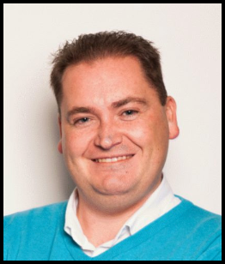
Panelists
Dennis Mertens, ITQ SDDC Consultant
Vladimir Velikov, Broadcom R&D Software Engineer
Wouter Kursten, ControlUP Senior Professional Services Engineer, TAM
Richard van Dantzig, ITQ SDDC Consultant
vCommunity and what’s in it for you!

Slide 4
Stay Connected & Get involved
vExpert (VMware’s Global Evangelist Program) – vexpert.vmware.com
VMware VMTN (Forums) – communities.vmware.com
VMUG (VMware User Group) – vmugnl.nl / vmug.com
VMware {code} : free developer program – developer.vmware.com
VMware Blogger Program – blogs.vmware.com
VMware Champions : appreciation and gain recognition, exclusive benefits
VMware Rewards : learn, participate and earn (rewards)
vBreakfast EMEA
vCommunity and what’s in it for you!

Slide 5
vExpert PROs
Dutch vExpert PROs (at the moment):
Bart Peeters
Johan Dijkstra
Joris Adriaanse
Ivan de Mes
Laurens van Duijn
Michelle Goossens
Remi Schipperus
Richard van Dantzig
Ronald de Jong
Wouter Kursten
https://vexpert.vmware.com/directory/pro
vCommunity and what’s in it for you!

Slide 6
vCommunity and what’s in it for you!

